Slide 1
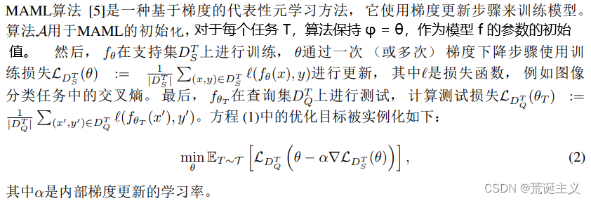
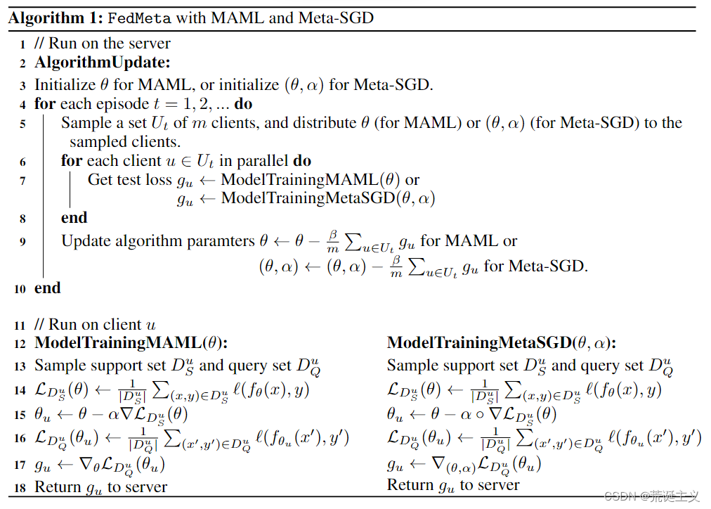
Meta Learning And Multi-Task in Federated Learning's Role
Meta Learning in Heterogeneity
WANG
Introduction
According to basic principles of Federated Learning and interpretability of distributed computation, Meta Learning can be used as one of training models in computation. By using algorithms of Meta Learning, for instance, MAML, it can be a effective way to solve questions.
Reflection From FedMeta
Using previous experience to guide the learning of new tasks, enabling machines to autonomously learn models for different tasks. When training on new tasks, it is only necessary to fine tune the initial model to achieve satisfactory learning performance with only a small amount of data.
The personalized ability of meta learning can solve the problem of statistical heterogeneity in federated learning. For example, the federated meta learning framework FedMeta maintains algorithms on the server-side and distributes them to the client-side for training, and then uploads the test results on the query set to the server for algorithm updates.
In meta learning, the goal is to learn a model on a series of tasks so that it can solve new tasks with only a small number of samples.
Initialization based meta learning algorithms, such as MAML, are well-known for their fast adaptation and good generalization on new tasks, making them particularly suitable for distributed training data with non IID and highly personalized federated settings.
In meta learning, algorithms can train tasks that contain different categories. For example, the Model agnostic Meta Learning (MAML) algorithm can provide initialization of the k-way classifier by meta training the k-way task without considering specific categories.
Methods
Reproducing "Improving Adaptive Runoff Forecasts in Data-Scarce Watersheds Through Personalized Federated Learning" and "(FedMeta)Federated Meta-Learning with Fast Convergence and Efficient Communication"
Understanding codes in github repos.
Expected completion time
Before January 5th, in these days of spare time, I will continue to read more papers in Meta Learning and Multi-Task Fields. And trying to do more practices about ML codes for improving my coding ability.
Mauris orci mi, varius id diam id, egestas auctor enim.
Department of Computer Science School of Engineering and Applied Sciences
leihanwa@buffalo.edu

